Slide 1
Digital Jazz Research A Transdisciplinary Approach
Klaus Frieler
Institut für Musikwissenschaft, Weimar-Jena
University of Music „Franz Liszt“ Weimar
SysMus 2019
HdPK Berlin
September 10, 2019

Slide 2

The Deaf Musicologist from Mars

Slide 3
It’s 1959

Slide 4
New York City

Slide 5
The East Village

Slide 6
The Deaf Martian Musicologist
Imagine Mr Green, a deaf Martian musicologist, who regularly visits the earth in disguise with his advanced measurement instruments, well-hidden in a shabby briefcase, to investigate human beings.
In 1959, he walks in a run-down café in the East Village in NYC, called the Five Spot.
The place is crowded and smoky.
On the bandstand three black and one white guy are operating some strange tools…
What does the Martian observe?

Slide 7
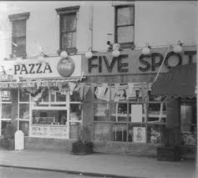
The Five Spot
A crowded and smoky bar

Slide 8
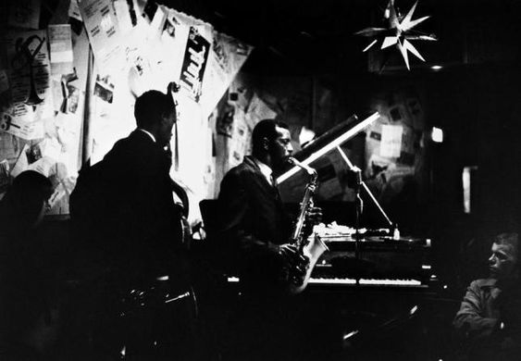



Slide 9
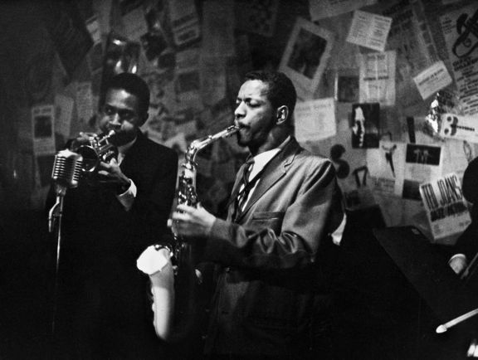
Weird tools
Notes:
The humans on the bandstand operate different tools.
Mr Green suspects that they produce acoustic waves, because two of the tool are stuck in the mouth
He makes a recording and produces a spectrogram.
In the spectrogram are many peaks extending horizontal in time; some of the sounds produced seem to be discrete units with a dominant frequency.
There are also vertical peaks, which are correlated in time with finger and arm movements of the guy behind a set of round boxes and metal discs on the bandstand.

Slide 10
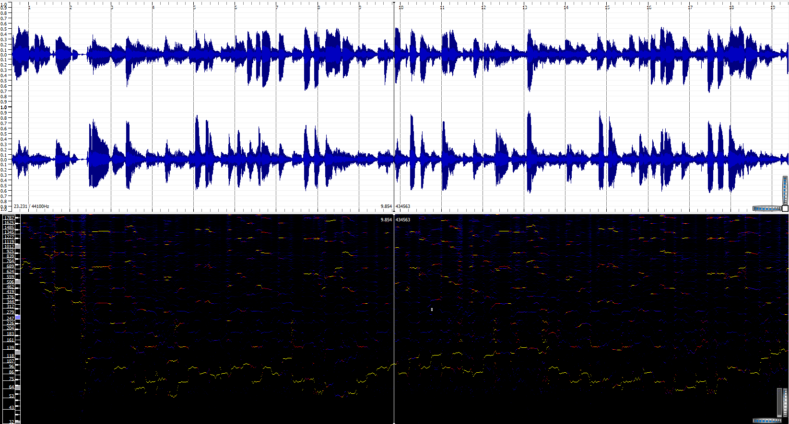

Slide 11
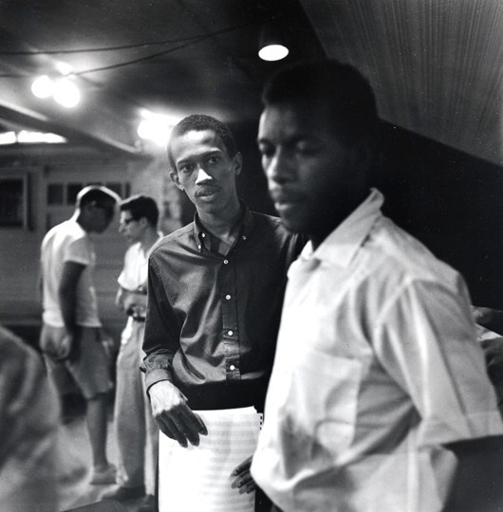

Slide 12
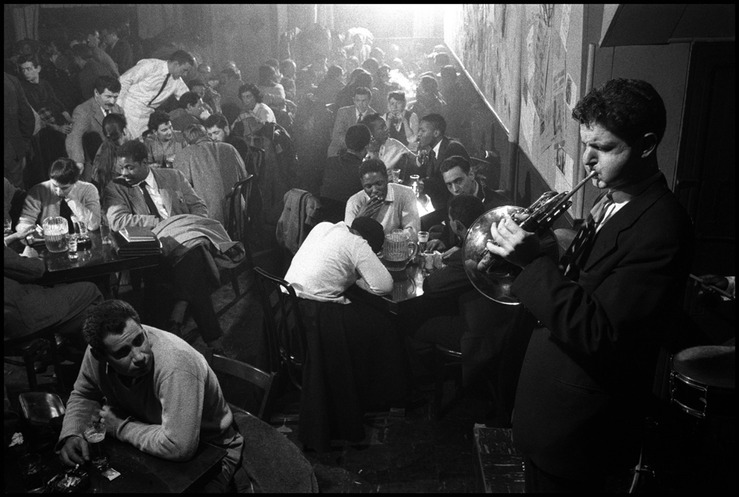
Notes:
People in the audience, pay attention to the people on the bandstand or move their mouths in direction to the others.
A face analysis reveals different states of the audience members, which one of his fellow Martian anthropologists dubbed “emotions”.
The audience display a wide range of emotions, but most of them involve “smiling” and “laughing”, but some also show “disgust” or “frown”.
People on the bandstand and in the audience move feet and other body parts in a somehow correlated way.
The white guy with the big body-shaped tool with four metal wires has a frame with glasses in front of his eyes.
And so on, and so forth…

Slide 13
The Deaf Martian Musicologist
The humans on the bandstand operate different tools.
Mr Green suspects that they produce acoustic waves, because two of the tool are stuck in the mouth
He makes a recording and produces a spectrogram.
In the spectrogram are many peaks extending horizontal in time; some of the sounds produced seem to be discrete units with a dominant frequency.
There are also vertical peaks, which are correlated in time with finger and arm movements of the guy behind a set of round boxes and metal discs on the bandstand.

Slide 14
The Deaf Martian Musicologist
Sometimes the humans on the bandstand play all together, but mostly only a subset of them is active.
Often, after someone stops playing, the people in the audience move their hands rhythmically but not in sync with the others.
The humans on the bandstand sometimes look or make gestures at each other.
Sometimes they laugh, but mostly they look serious, detached, focused or simply “cool”.
Every hour or so they stop and leave the bandstand for 30 min.
Spectograms in these breaks still reveal similar patterns as before.

Slide 15
The Deaf Martian Musicologist
People in the audience, pay attention to the people on the bandstand or move their mouths in direction to the others.
A face analysis reveals different states of the audience members, which one of his fellow Martian anthropologists dubbed “emotions”.
The audience display a wide range of emotions, but most of them involve “smiling” and “laughing”, but some also show “disgust” or “frown”.
People on the bandstand and in the audience move feet and other body parts in a somehow correlated way.
The white guy with the big body-shaped tool with four metal wires has a frame with glasses in front of his eyes.
And so on, and so forth…

Slide 16
How to make sense of all of this
?

Slide 17
Use digital jazz research!

Slide 18
Digital Jazz Research
Using computers to research jazz.
Branch of computational musicology.
Collection and curation of big data sets (improved reliability of results).
Statistical and algorithmic analyses.
Development & test of cognitive and generative models.
Enables analysis pathways that are otherwise hard to obtain (e.g., timbre, intensity, intonation).
General acceleration of research processes.

Slide 19
Digital Jazz Research
Transcription
Audio
Metadata
Score
Sound Analysis
Music Analysis
Statistics
Results

Slide 20
Jazz Research Questions
Psychological perspective
Creative process: qualitative and quantitative models
Performance aspects: Micro-timing, intonation, timbre, loudness
General psychological questions (e.g., sequence generation)
Historical/cultural perspective
Stylistic developments, comparison of performers
Testing jazz theory (e.g., chords vs. scales)
Applications (e.g., jazz education)
Interaction of perspectives

Slide 21


DFG funded research project at the University of Music “Franz Liszt” Weimar (10/2012-4/2017).
Compilation of the Weimar Jazz Database with 456 high-quality monophonic jazz solo transcriptions.
Development of analysis tools (MeloSpySuite, MeloSpyGUI).
Follow-up project (10/2017-09/2019)
International project (UK, US, FR, DE)
Dedicated to patterns and licks
DTL1000 Database (~1,700 solos) with automated transcriptions and discographic metadata
Development of tools for pattern mining and search

Slide 22
Weimar Jazz Database (WJD)
456 solos by 78 different performers.
200,809 tone events.
Top performer: Coltrane (20), Davis (19), Parker (17), Rollins (13), Liebman (11), Brecker (10), Shorter (10), S. Coleman (10).
Styles: traditional (32), swing (66), bebop (56), cool (54), hard bop (76), post-bop (147), free (5 = Ornette Coleman).
Instruments: ts (158), tp (101), as (80), tb (26), ss (23), other (68).
Time range: 1925 – 2009
Focus on the jazz canon, nearly exclusively US-American musicians.

Slide 23
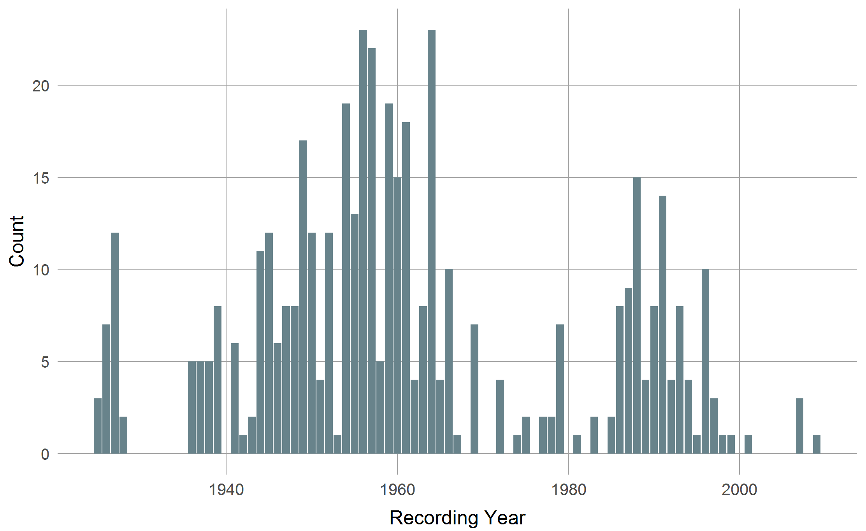
WJD: Solos over time
Golden Era
Bigband Gap
Fusion Gap

Slide 24
Examples

Slide 25

Performance Aspects

Slide 26
What is the distribution of tempos in jazz?

Slide 27
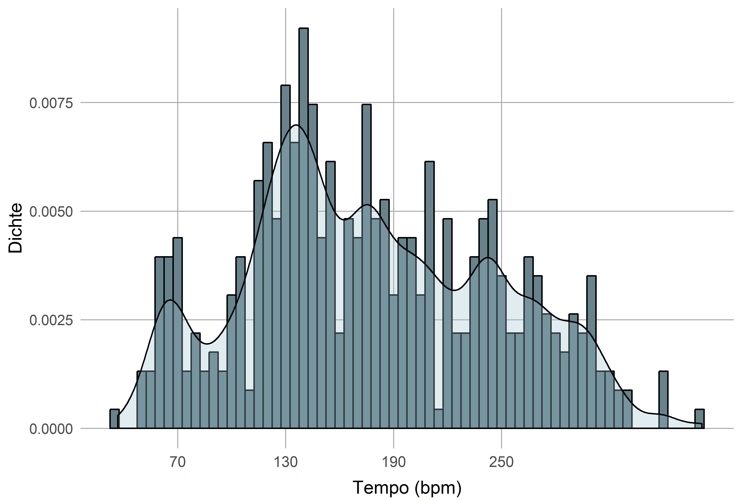
Tempo Distribution WJD
133 bpm
182 bpm
234 bpm
73 bpm
289 bpm

Slide 28
Tempo Distribution WJD
Tempo fields follow a harmonic series over f₀ = 58.5 bpm (~1 Hz)
Indicator for an adaptable central neural oscillator for beat generation!
Tempo Field | Partial | Nominal f₀ | Δ f
73.3 | 1:1 | 58.5 | -14.8
133.0 | 2:1 | 117.0 | -15.6
181.7 | 3:1 | 175.5 | -6.2
233.8 | 4:1 | 234.0 | 0.2
289.5 | 5:1 | 292.5 | 3.0
 |  |  | |Δf| = 7.8

Slide 29
What is swing?

Slide 30
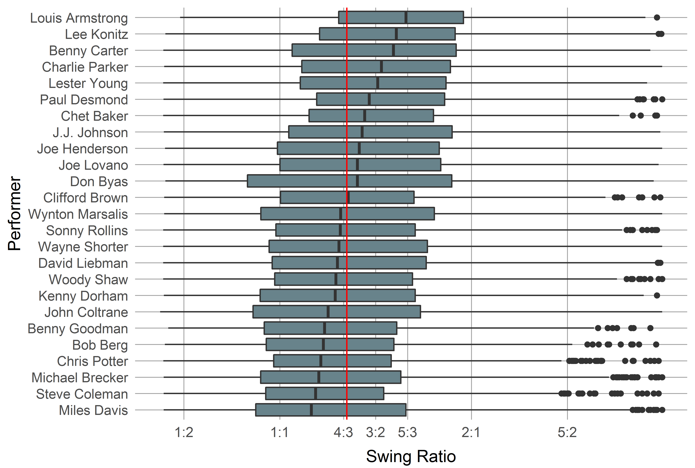
Swing Ratio
Average swing ratio (long:short) is 4:3.

Slide 31
Stylometrics

Slide 32
How does jazz differ from other musical styles?

Slide 33
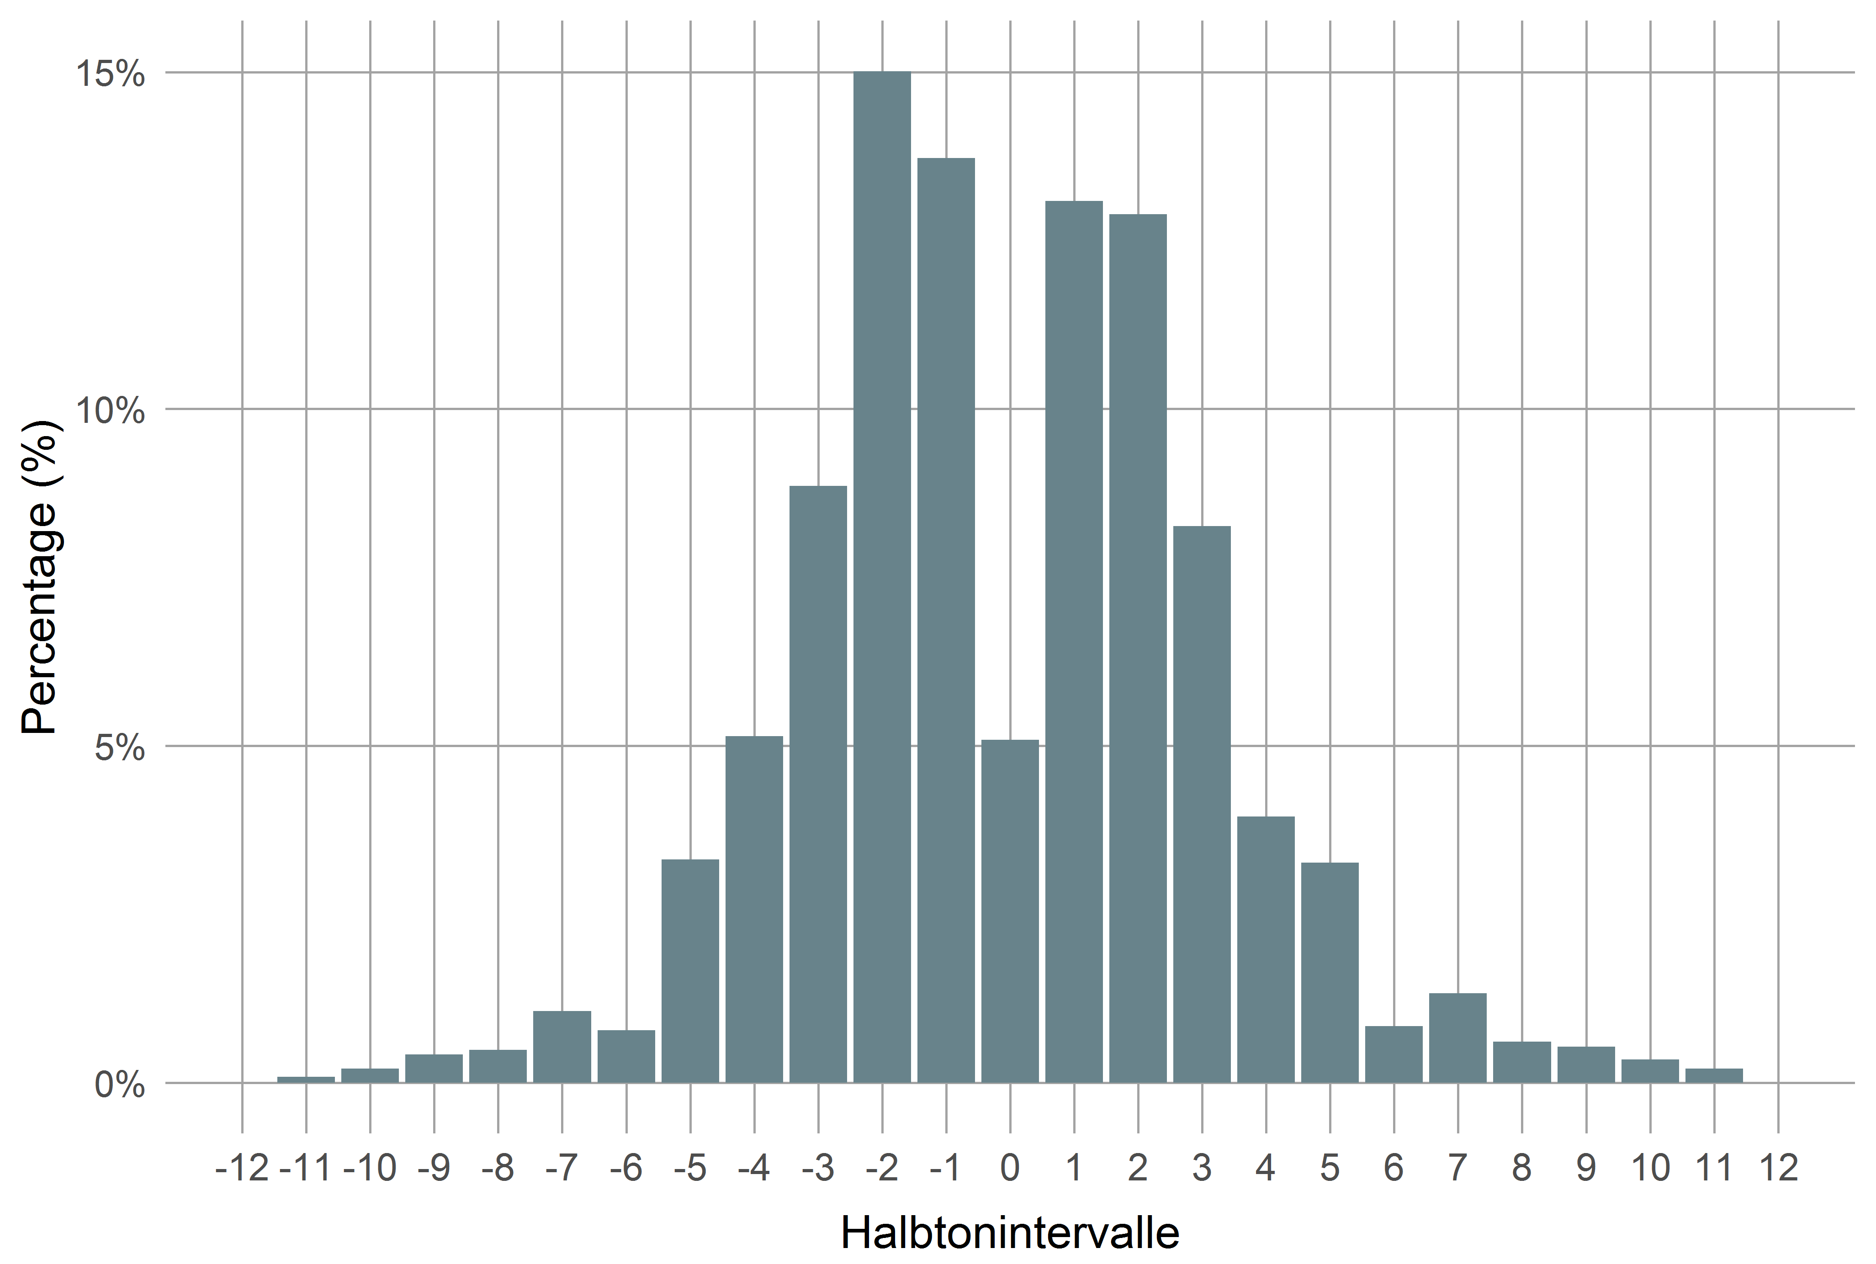
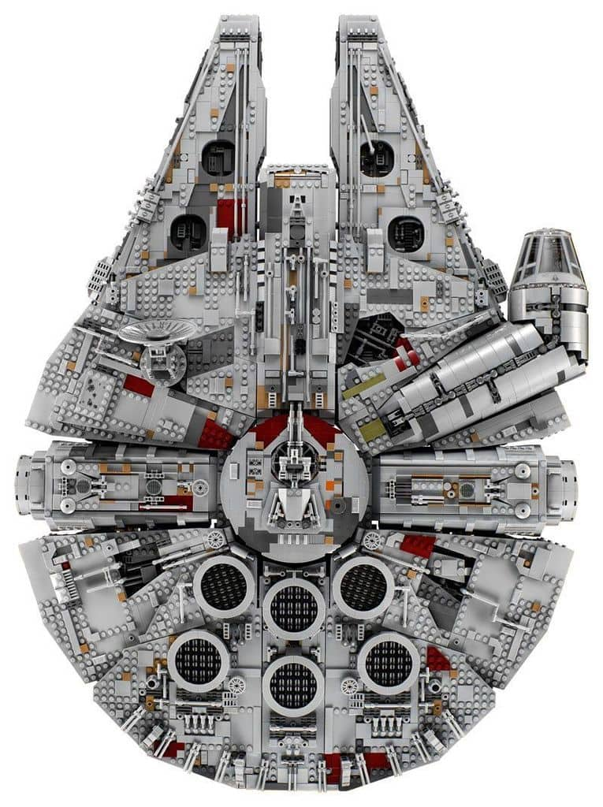
Interval Distribution

Slide 34
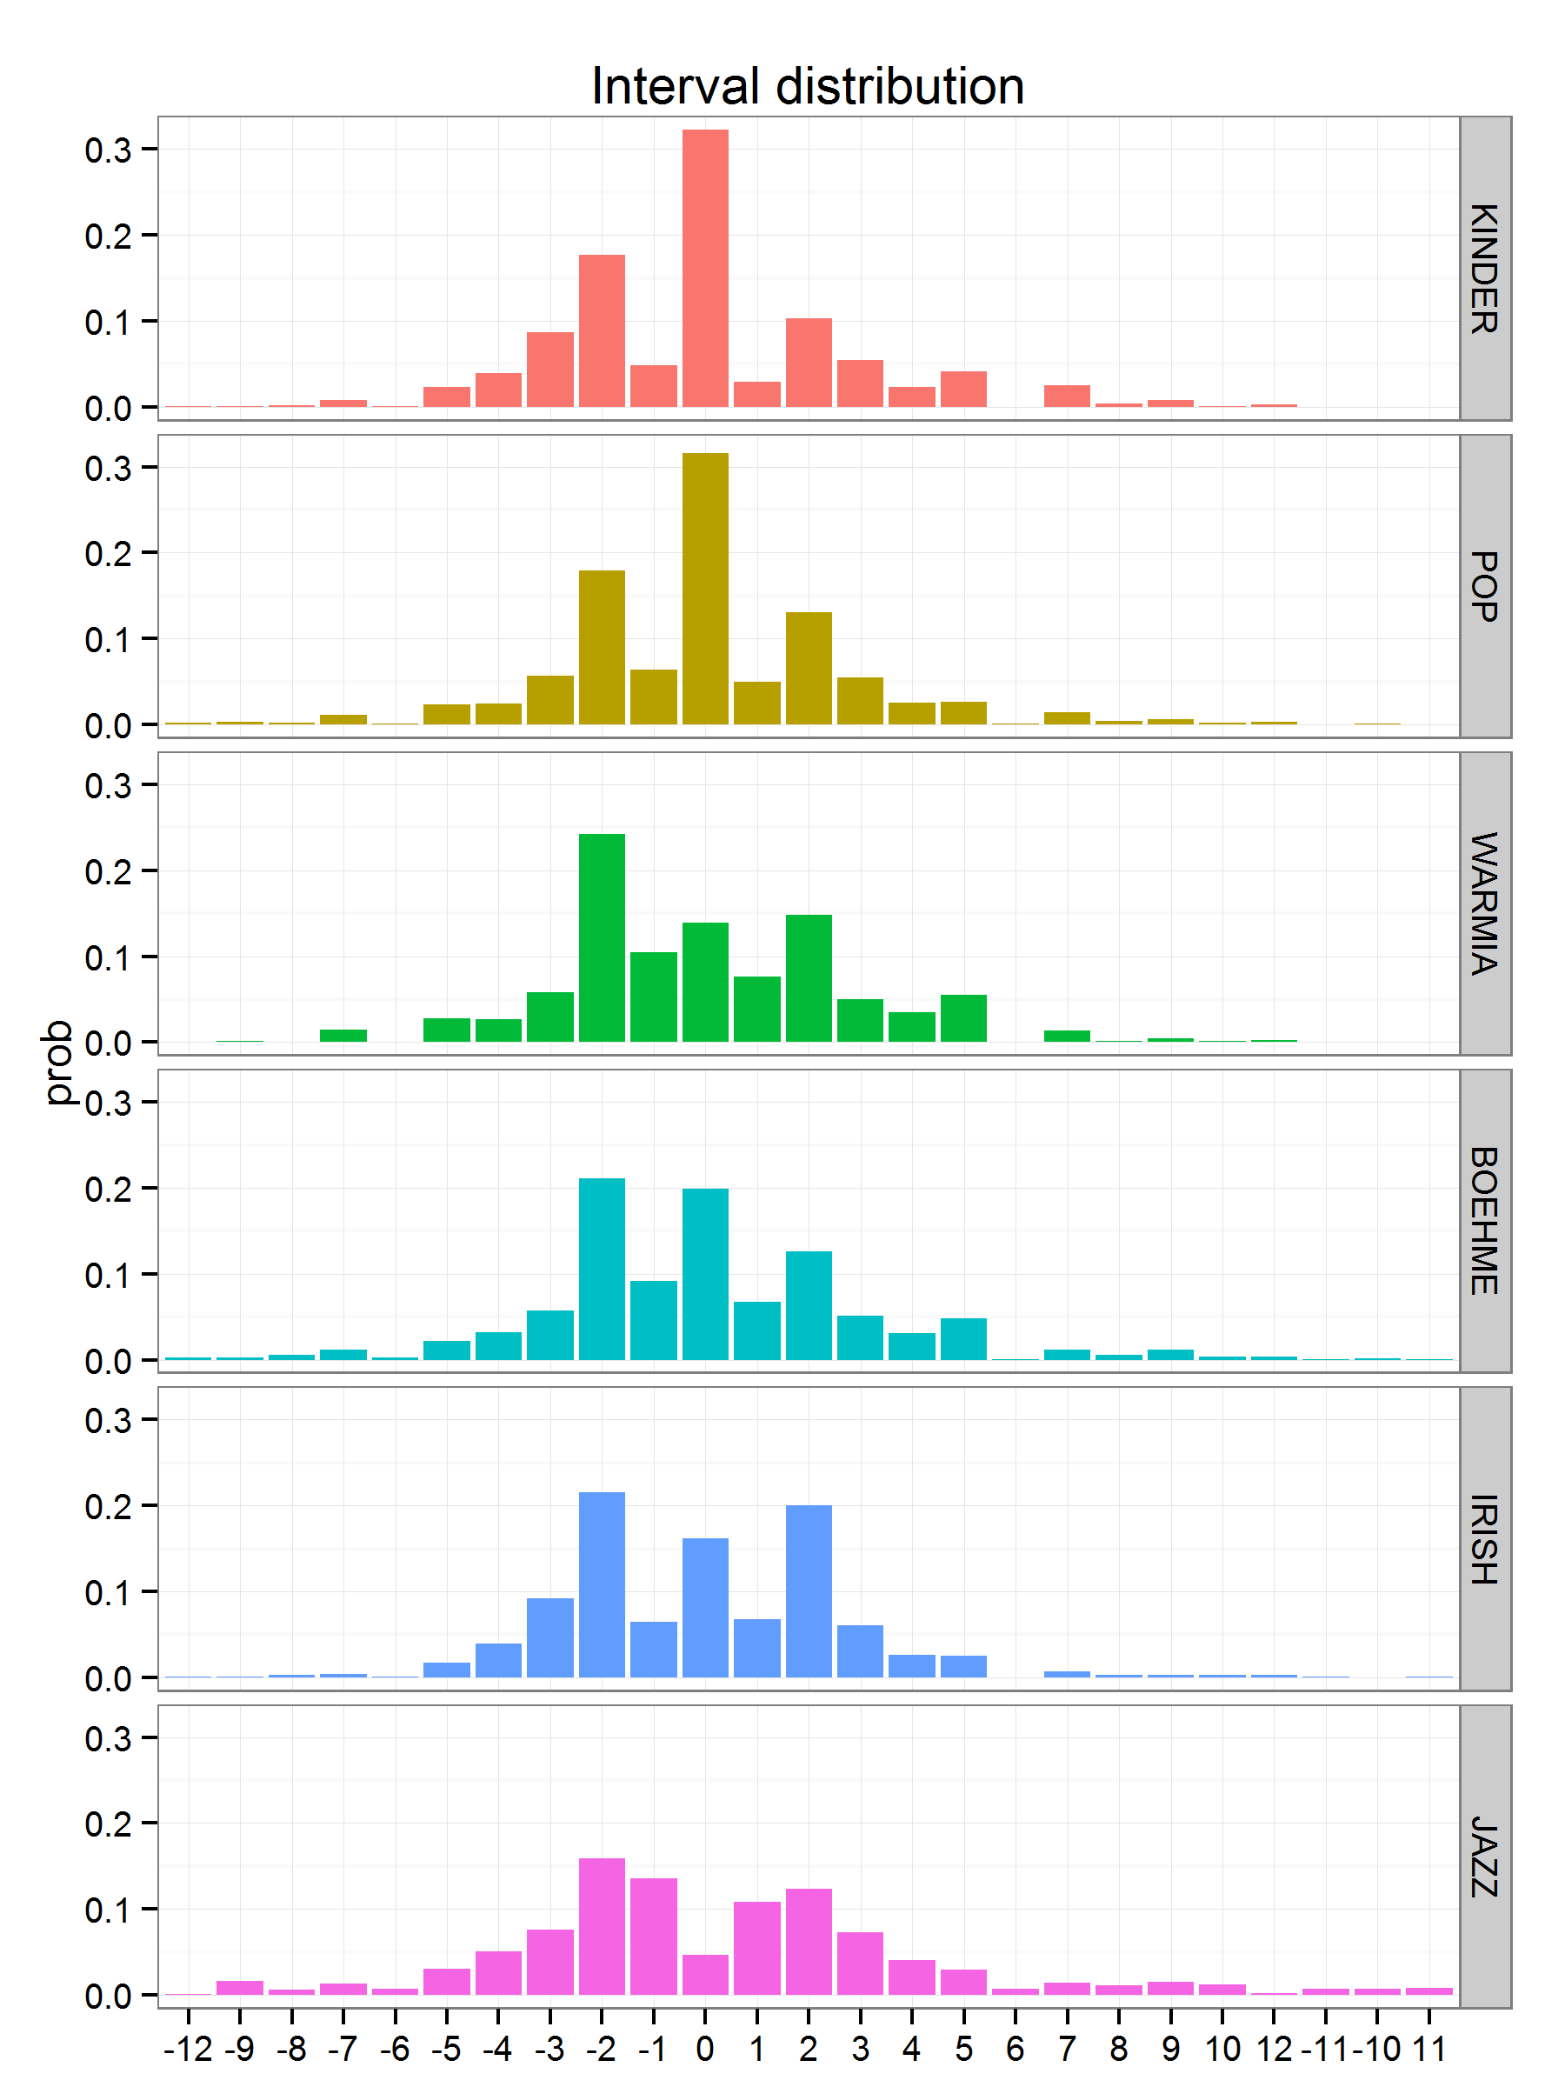
intervallverteilung
Differences:
Avoid tone repetitions
Much more chromatic
Larger intervals more frequent
Similarities:
Step movement prevalent
Descending/ascending asymmetry

Slide 35
What are the differences between certain performers?

Slide 36
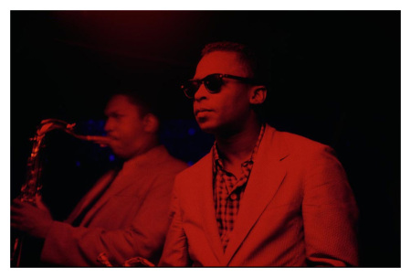
Miles vs. Trane
 | John Coltrane | Miles Davis
Rhythm | Mostly fast lines („Sheets of sound“) | Rhythmically more diverse
 |  | Longer tones & pauses
Intervals | More descending | More ascending
 | Less tone repetitions | More tone repetitions
 | Larger intervals | Smaller intervals
 | More thirds & arpeggios | Fewer thirds
Pitch | Larger pitch range | Smaller pitch range
 |  | Avoids thirds, more blue notes
Midlevel Units | More lines, expressive & fragments | More licks, melody & void
Patterns | More patterns | Fewer patterns
 | No common pattern vocabulary

Slide 37
Hot vs. Cool
Big Five | John Coltrane | Miles Davis
Openess | High | High
Extraversion | Low | Low
Conscientiousness | Very High | High
Neuroticism | High | High
Agreeableness | High | Low

Slide 38
How did solos change over time?

Slide 39
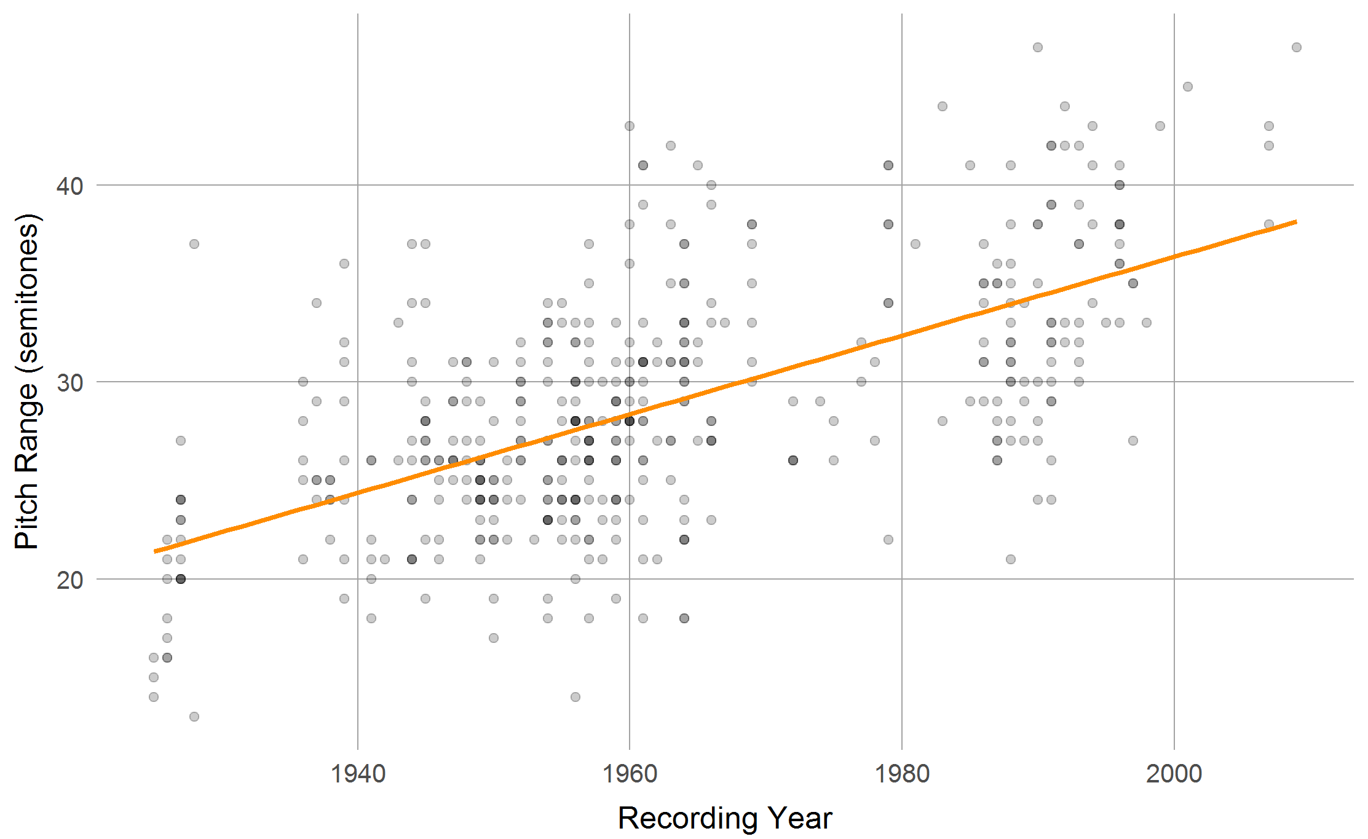
Pitch Range
Expanding ranges (ρ = 0.596, p <.001)

Slide 40
Jazz solos over time
Solos became longer
Rhythms more uniform
More fast notes
More lines
Expanding ambitus
Increasing exhaustion of pitch space
Fifths of chords decrease
Tonally more complex
More chromatics
Wider intervals
More diverse interval combinations
Tones more stable
Articulation more diverse
Intonation more “precise”
Expressivity increased
More diverse overall design of solos
https://jazzomat.hfm-weimar.de/feature_history_jazz/

Slide 41
Jazz solos over time
General trends to higher
complexity
virtuosity
expressivity
sophistication
Why?
The “academization” of jazz?
A “natural” evolution of (Western) music styles due to innovation pressures of the economic and aesthetic market?

Slide 42
Psychological models of jazz improvisation

Slide 43
How do jazz musicians plan and shape solos?

Slide 44
Midlevel Analysis
Assumes a hierarchical process of improvisation.
Players have short-term plans (“sketch-plans”, “ideas”) on a middle time level ( ~ few seconds).
Midlevel analysis (MLA) tries to describe these underlying ideas & plans
Continuous, non-overlapping and gap-less annotation of the musical event stream with midlevel units (MLUs).
Hierarchical category system with 9 main types
line, lick, rhythm, expressive, theme, quote, fragment, void
Extracted from the data using qualitative methods.
Includes annotation of motivic relationships between MLUs.

Slide 45
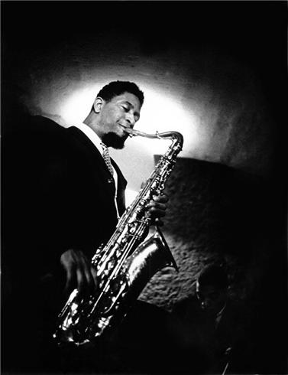
Flow of Ideas Sonny Rollins: Blue Seven

Slide 46
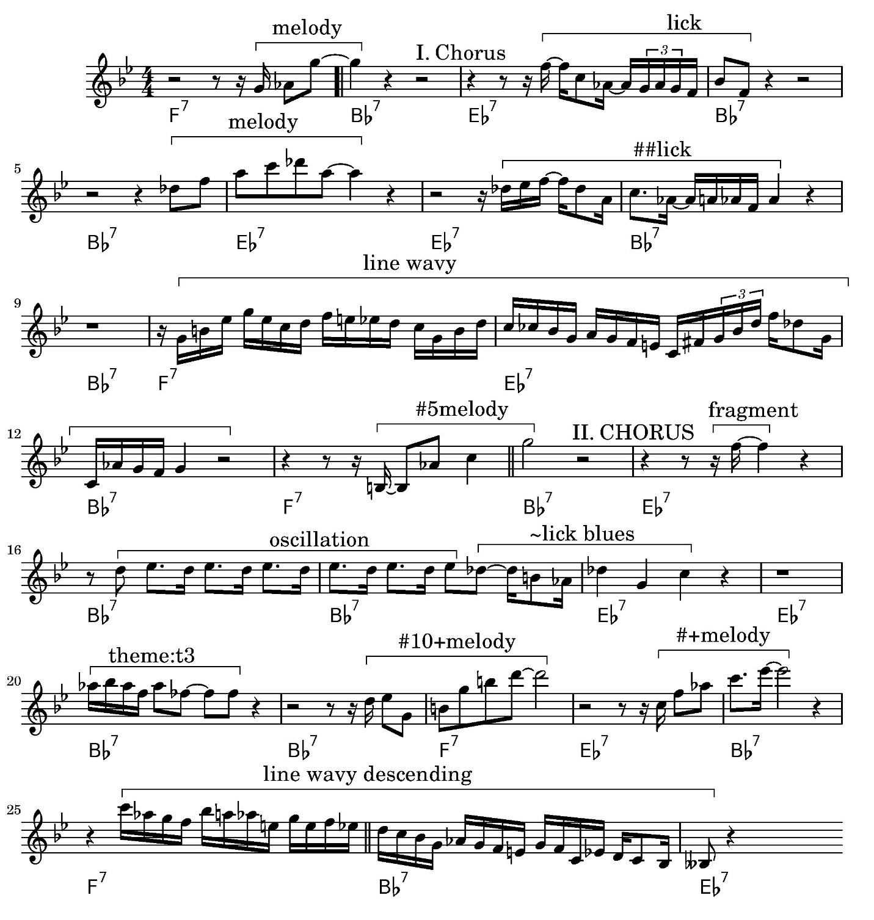

Slide 47
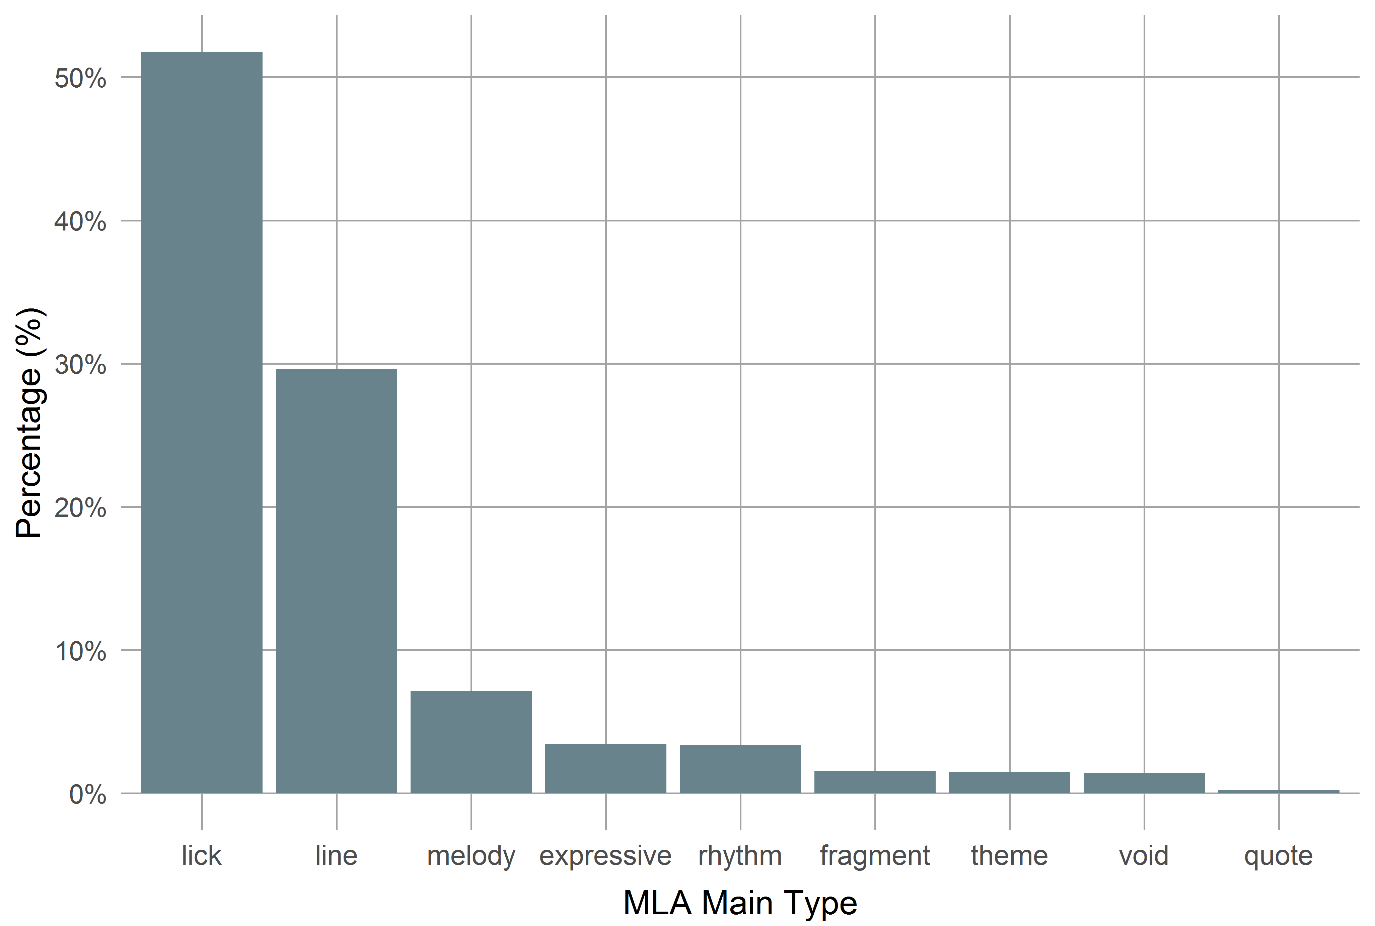
Playing Ideas
Average duration: 2.25 s (SD = 1.57s)
Coincides with subjective presence time

Slide 48
How do jazz improvisers find the right notes?

Slide 49
Patterns in Jazz
Licks and formulas (patterns) important for jazz improvisation.
Patterns are short snippets (N-grams) in a set of sequences (intervals, pitches etc).
Usually subject to certain properties (e.g., length, document & relative frequencies).
Licks are repeated patterns of a recognizable musical gestalt (not always identical with licks in the sense of MLA)

Slide 50
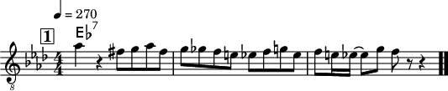
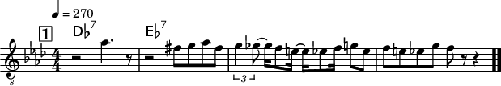
Pattern Example
18-tone interval N-gram by Bob Berg on „Angles“
[-2, 1, 1, -2, 1, -1, -1, -1, -1, 2, 2, -4, 2, -1, -1, 4, -2]
Measure 30
Measure 108

Slide 51
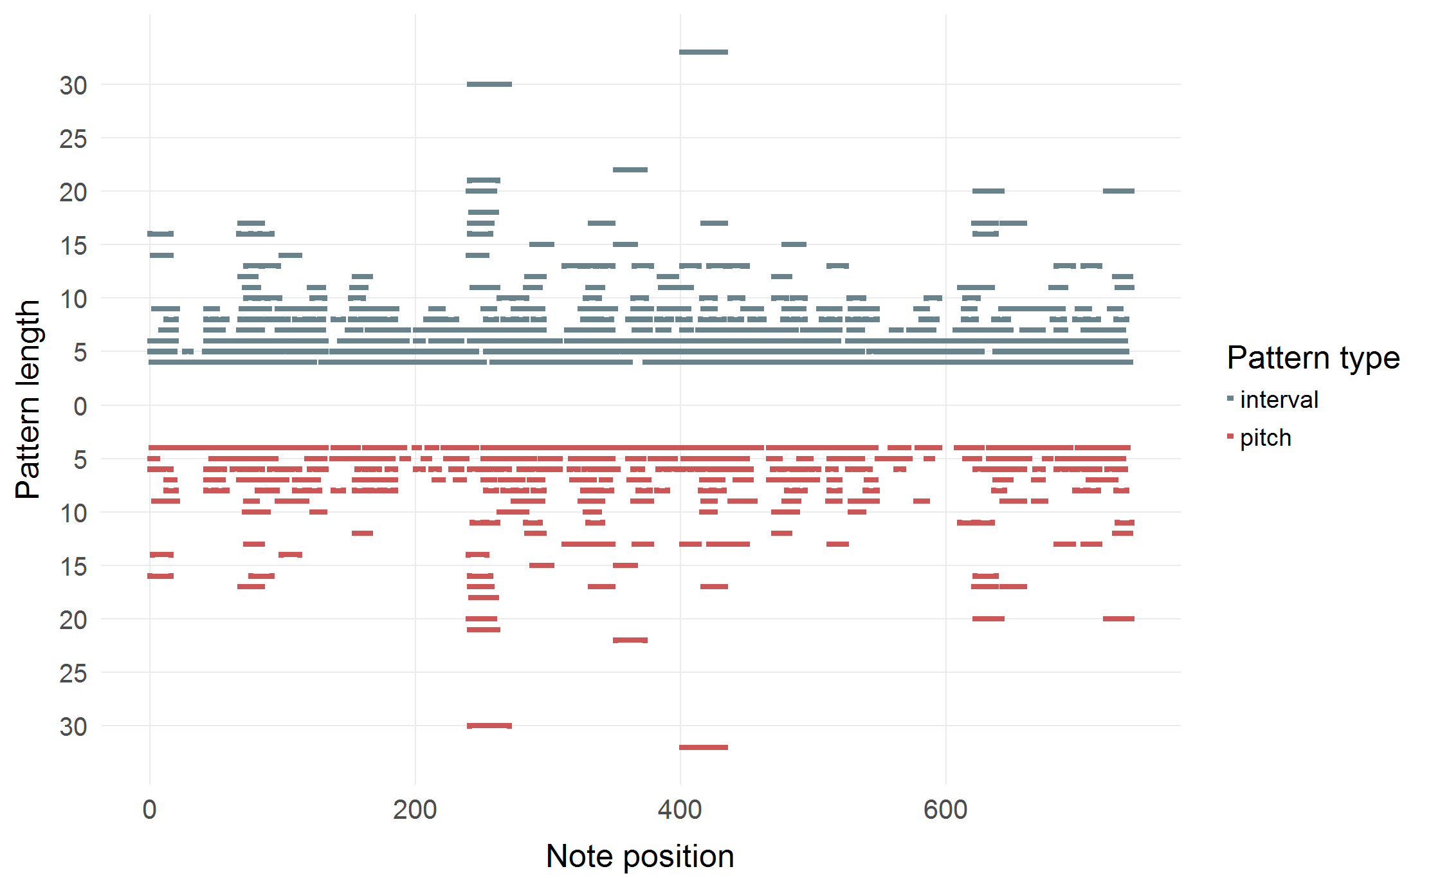
Pattern usage
Charlie Parker: Ko-ko (1945)

Slide 52
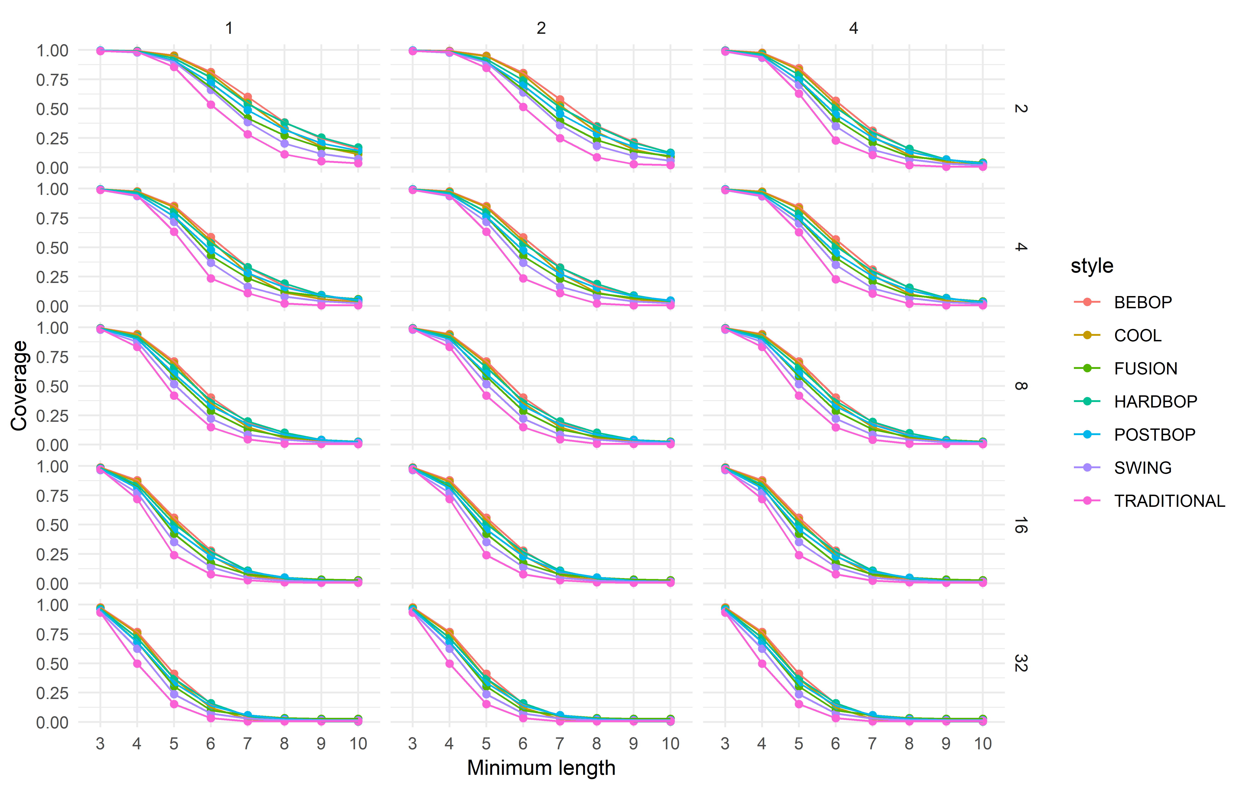
Pattern coverage
Solo frequency
100 % coverage by
N-grams with N ≥ 4
occurring at least in
two different solos
Corpus frequency
50-75 % coverage by
N-grams with N ≥ 4
occurring at least 32
times in at least
4 different solos
Pattern coverage: Number of notes in a solo contained at least in one N-gram

Slide 53
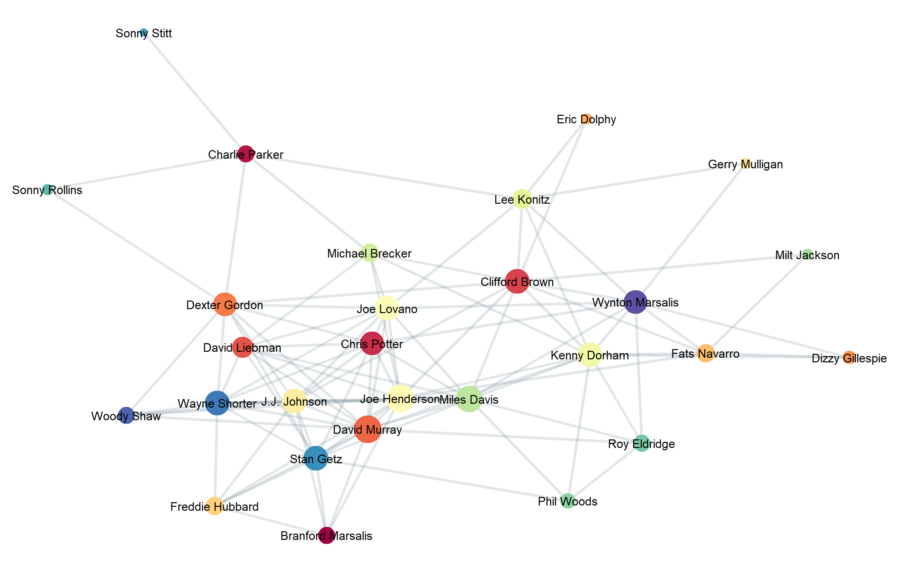
Pattern commonalities
Pattern commonality Number of common N-grams between performers

Slide 54
Does jazz learning follow jazz history?

Slide 55
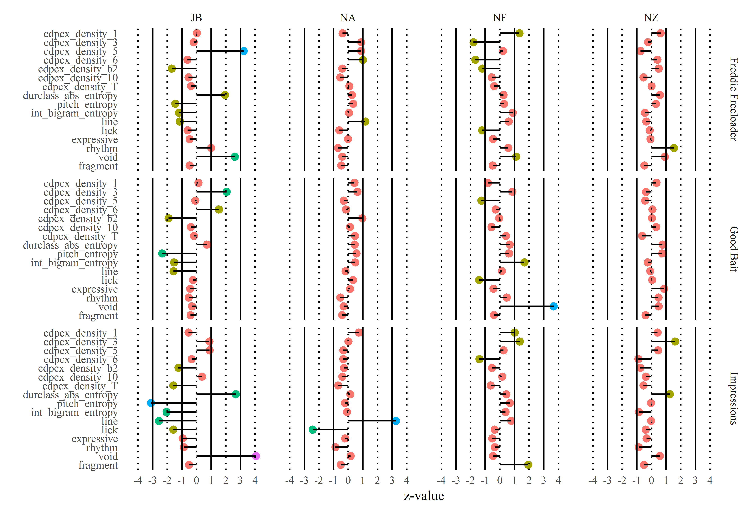
Jazz students vs. WJD
Classified:
1st semester
4th semester
8th semester
graduated
TRADITIONAL
BEBOP
POSTBOP
POSTBOP

Slide 56
Summary & Conclusion

Slide 57
What could Mr Green learn?
Jazz tempos show harmonic series over a base tempo ~60 Hz
→ Evidence for a central neural oscillator
Swing ratio is about 4:3 (with large variation)
→ Implication and challenges for a theory of rhythm
Melodic movement prefers small steps “jump up, trickle down”
→ Biological origins of melody, music universals
Jazz solos shows distinct features that aim at complication
→ Structural musical features serve as social signifier
General trend in jazz and other music to higher complexity
Behavioural economics of music, innovation pressure

Slide 58
What could Mr Green learn?
Jazz players use motor plans with a 2-3s time span
→ Implications for theories of action, subjective presence time
Jazz players make heavy use of overlearned patterns
→ Implication for theories of action and motor learning
Jazz players transmit and share patterns with each other
→ Implication for theory of creativity and cultural formation
Jazz learning seems to follow jazz history
→ Ontogenesis follows phylogenesis

Slide 59
Conclusion
Jazz research is a good example for the transdisciplinary nature of music science: musicology learns from other disciplines.
Jazz improvisation is an excellent test bed for theories of creativity and behaviour control in general: other disciplines learn from musicology.
Computational and statistical methods greatly facilitate the transdisciplinary view-point.
Manifesto: Against a dichotomy of systematic and historic musicology, towards an integrated approach!

Slide 60
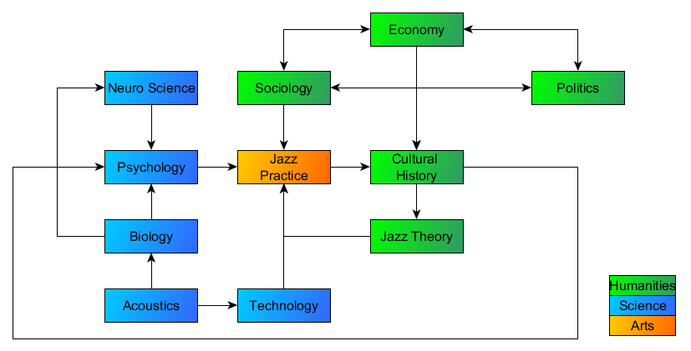
Transdisciplinary Jazz Research

Slide 61
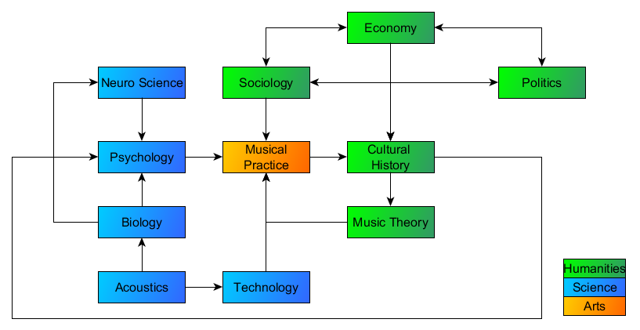
Transdisciplinary Musicology

Slide 62

Outlook
Analysing multitrack recordings (e.g., Montreux archive).
Polyphonic soli (piano, guitar).
Rhythm section/accompaniment.
Interaction, synchronization.
Analysis-by-synthesis: Test of improvisation models by automatic generation of jazz soli.
Larger and diverse databases (next is DTL1000).
Fully automated transcription.

Slide 63

Thank you!
https://jazzomat.hfm-weimar.de/
The Jazzomat Team: Martin Pfleiderer, Jakob Abeßer, Wolf-Georg Zaddach, Friederike Bartel, Benjamin Burkhard, Martin Breternitz, Peter Heppner, Yvette Kneisel, Benedikt Koch, Simon Meininger, Benjamin Napravnik, Albrecht Probst, Franziska Risch, Lydia Schulz, Amelie Zimmermann, Alaa Zouiten
The DTL Team: Frank Höger, Simon Dixon, Polina Proutskova, Tillman Weyde, Daniel Wolff, Helene-Camille Crayencour, Dogac Basaran, Geoffroy Peeters, Krin Gabbard, Andrew Vogel, Gabriel Solis, Lucas Henry

